Slide 1
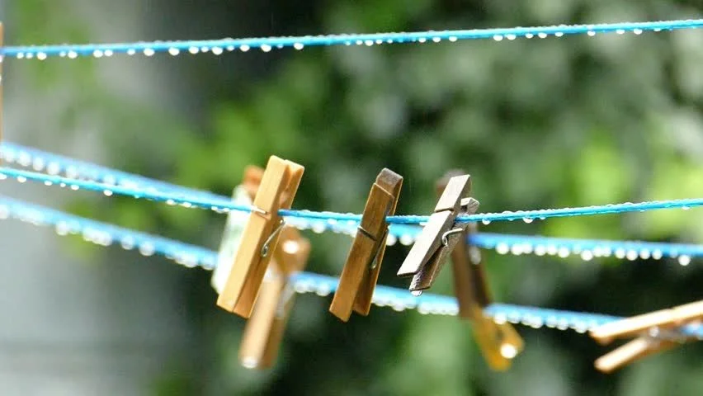
Its Raining Then Don’t forget your clothes hanging under the rain
Lucio Squitieri mat. 0522500984

Slide 2
Why this idea?
The idea is to avoid people(especially me) to forget their clothes hanging outside under the rain because they didn’t notice or they weren’t at home when it started to rain.
How?
To help these people IRT will notify the user that is raining lightly or heavier and help them take action like calling someone to pick up the clothes.

Slide 3





Technologies
Nuclio is a high-performance "serverless" framework focused on data, I/O, and compute intensive workloads.
RabbitMQ one of the most popular open-source message brokers that uses amqp
NodeJS is an open-source, cross-platform runtime system for the execution of Javascript code.
Telegram is messaging system.
TelegrafJS framework to create a bot on telegram.

Slide 4
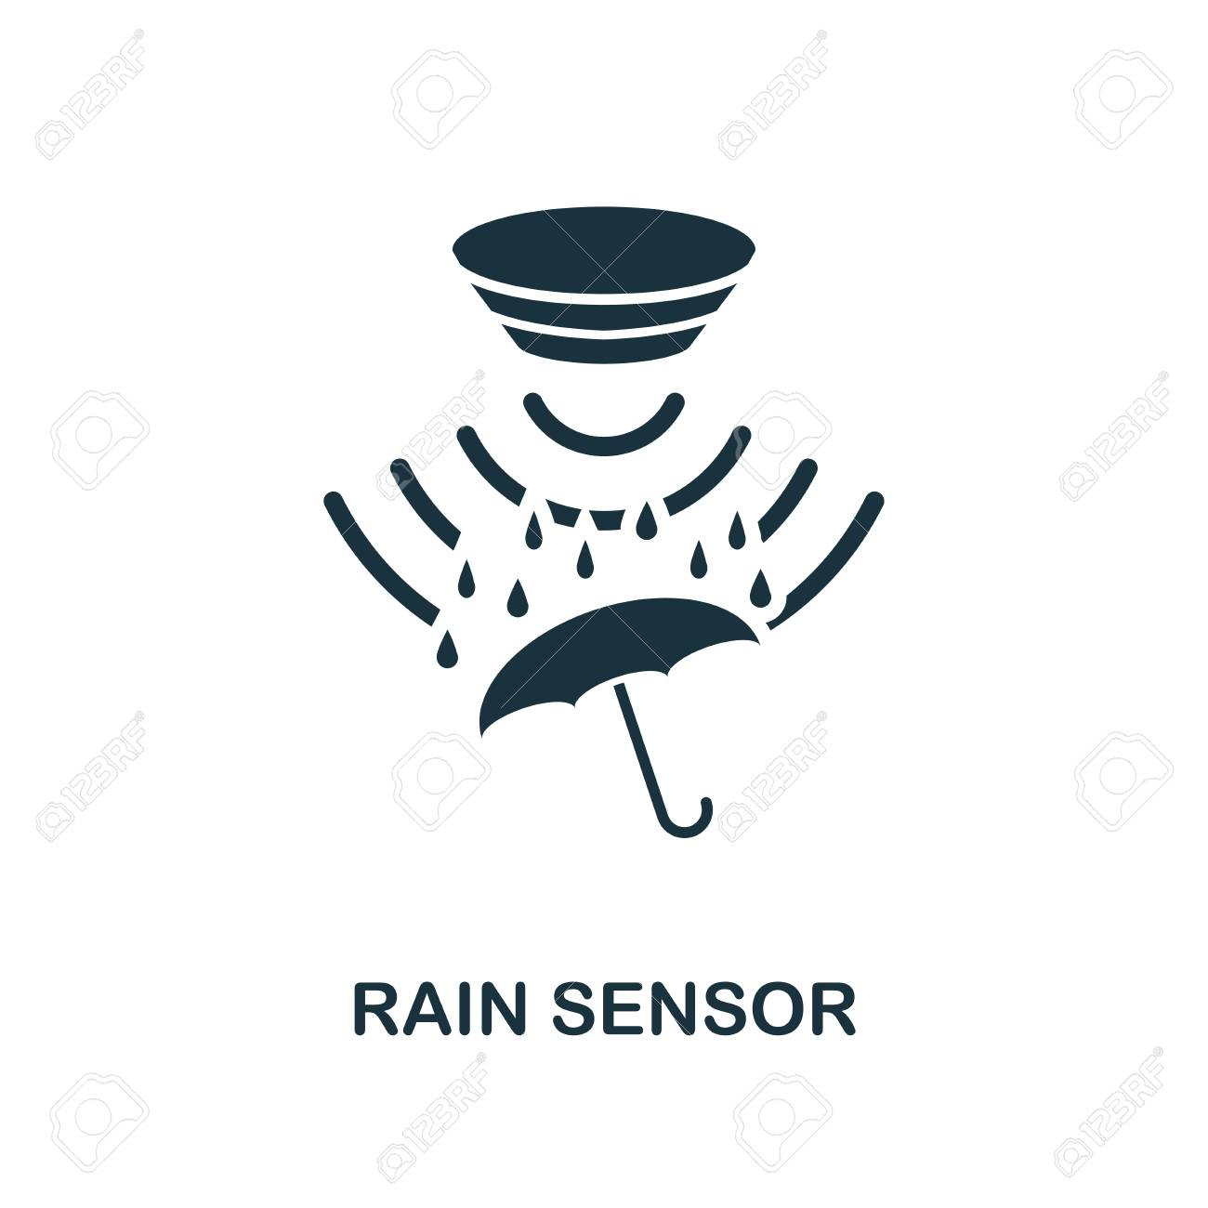



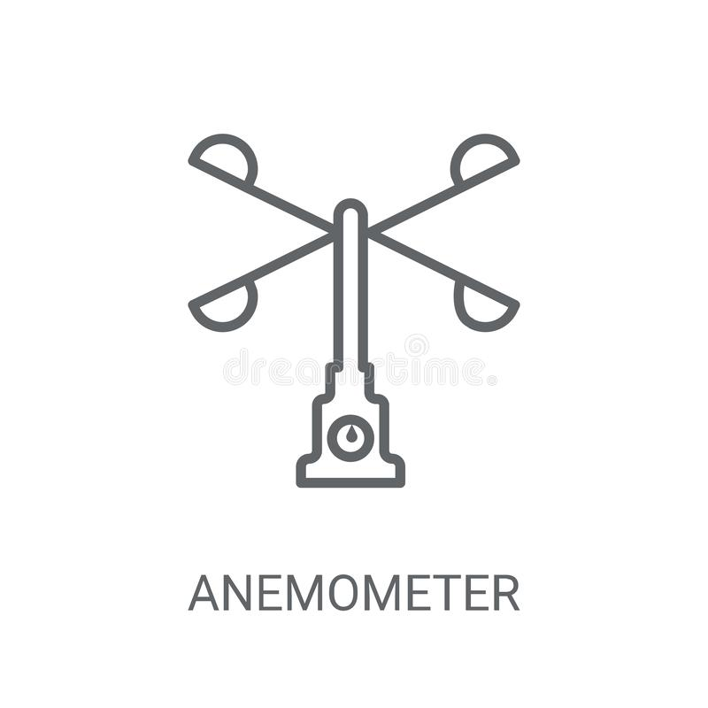

Architecture
IRT
iot/sensors/infoRain
consumer-rain
iot/rainAlert
MQTT Client
iot/sensors/infoWind
consumer-wind
iot/windAlert
Bot telegram

Slide 5

Thanks for the attention, lets proceed with the demo

